Slide 1
Personalized Medicine and Cancer Treatment
Yepeng Li

Slide 2
Background
Precision medicine, genetic testing and cancer treatment.
Huge amount of manual work still required.
The project is to distinguish the mutations that contribute to tumor growth (drivers) from the neutral mutations (passengers).
To develop a Machine Learning algorithm that, using this knowledge base as a baseline, automatically classifies genetic variations.

Slide 3
Data set
Kaggle competition: Personalized medicine and Cancer treatment
ID | Gene | Variation | Class
0 | FAM58A | Truncating Mutations | 1
1 | CBL | W802* | 2
2 | CBL | Q249E | 2
3 | CBL | N454D | 3
4 | CBL | L399V | 4

Slide 4
ID | Text
0 | Cyclin-dependent kinases (CDKs) regulate a var...
1 | Abstract Background Non-small cell lung canc...
2 | Abstract Background Non-small cell lung canc...
3 | Recent evidence has demonstrated that acquired...
4 | Oncogenic mutations in the monomeric Casitas B...

Slide 5
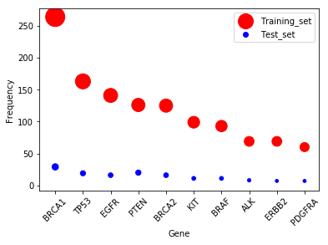
Explanatory data analysis
Top 10 occurred genes

Slide 6
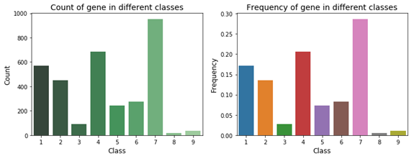
Gene frequency in nine mutation classes

Slide 7
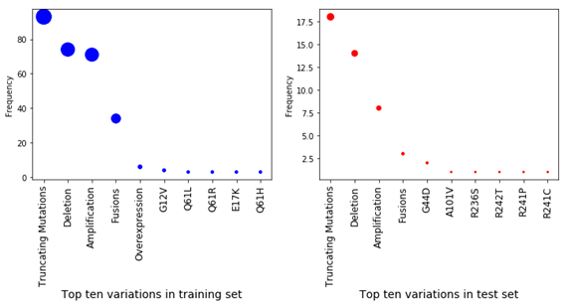
Top 10 variations

Slide 8
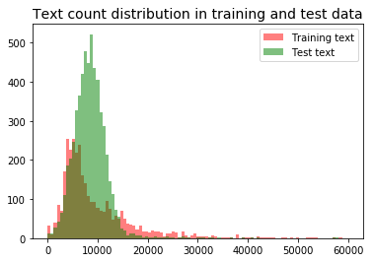
Text length overview

Slide 9
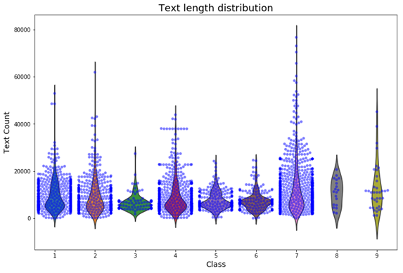
Text length distribution by class

Slide 10
Top 10 TF-IDF features in class 2 and 7
Gene distribution analysis shows top one gene EGFR ranks first in class 2 and 7.
Variation distribution analysis shows Amplification and Fusions (top 2 variations) mainly located in class 2 and 7.
Tf-idf is known as one good technique to use for text transformation and get good features out of text for training our machine learning model.

Slide 11
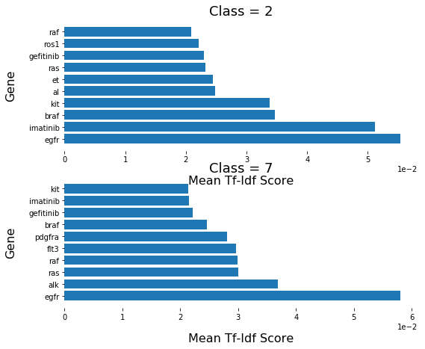
There are seven common text features in the two classes. There are 70% similarity for the top 10 text features between class 2 and class 7!

Slide 12
Base model building without text processing
In the basic model we used variable 'Gene' and 'Variation' as predictors.
Selecting the variations which count more or equal to 5.
With the logistic regression classifier we get test accuracy is 0.93.

Slide 13
Text processing and Model building
Bag of words and TF-IDF
 | log loss | test accuracy
Count vector + Naïve Bays | 13.53 | 0.6
TFIDF + Naïve Bays | 6.51 | 0.62
TFIDF + Random Forest | 1.23 | 0.6
TFIDF + Gradient Boost | 1.11 | 0.63

Slide 14
Summary:
Count vector and tf-idf are used to get word vector. Stop words is 'English'.
Tf-idf has better performance than the count vector.
Using Naive bays, Random forest and Gradient boost method to build the classifying model. The accuracy of test set is from 0.52 to 0.63. And GBM performs best.

Slide 15
Bag of words and TF-IDF with new stop words
Scientific terminology and stop words
Research field related stop words
Paper notation quirks

Slide 16
 | log loss | test accuracy
Count vector + Naïve Bays | 1.24 | 0.59
TFIDF + Naïve Bays | 1.23 | 0.6
TFIDF + Random Forest | 1.23 | 0.59
TFIDF + Gradient Boost | 1.1 | 0.62

Slide 17
Truncated SVD
 | log loss | test accuracy
Truncted SVD + Logistic regression | 1.54 | 0.48
Truncted SVD + Random Forest | 1.33 | 0.53
Truncted SVD/TFIDF + Logistic regression | 1.52 | 0.46
Truncted SVD/TFIDF + Random Forest | 1.34 | 0.5
Truncted SVD/TFIDF + Support vector machine | 1.43 | 0.48

Slide 18
Word2vec
 | log loss | test accuracy
Logistic regression | 1.37 | 0.51
Random Forest | 1.37 | 0.52

Slide 19
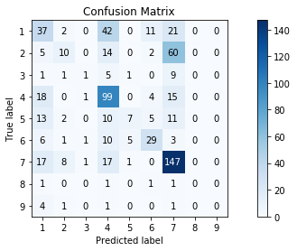
LSTM
Keras Model:
Log loss: 1.37
Accuracy: 0.50

Slide 20
Future job
Trying to find better way to get word vector.
Normalizing text data. For example, deleting the duplicate parts, citing only the abstract part of the paper.

